Slide 1
Exploring ASP .NET Core 3.0 and Azure App Service
CodeSanook Meetup #03 Jose Barbosa

Slide 2
.NET Overview and Roadmap

Slide 3














Your platform for building anything
DESKTOP
WEB
CLOUD
MOBILE
GAMING
IoT
AI
.NET

Slide 4
.NET Growth continues
>1 million .NET Core developers
Visual Studio, Visual Studio for Mac, Visual Studio Code
Visual Studio
+1 million new monthly active .NET developers in last year

Slide 5




.NET Core 3
C#
.NET
Big data
Machine Learning
Mobile development
Windows desktop
C# 8.0
Web & microservices
.NET vNext

Slide 6
What are we going to talk about today?
Web & microservices

Slide 7

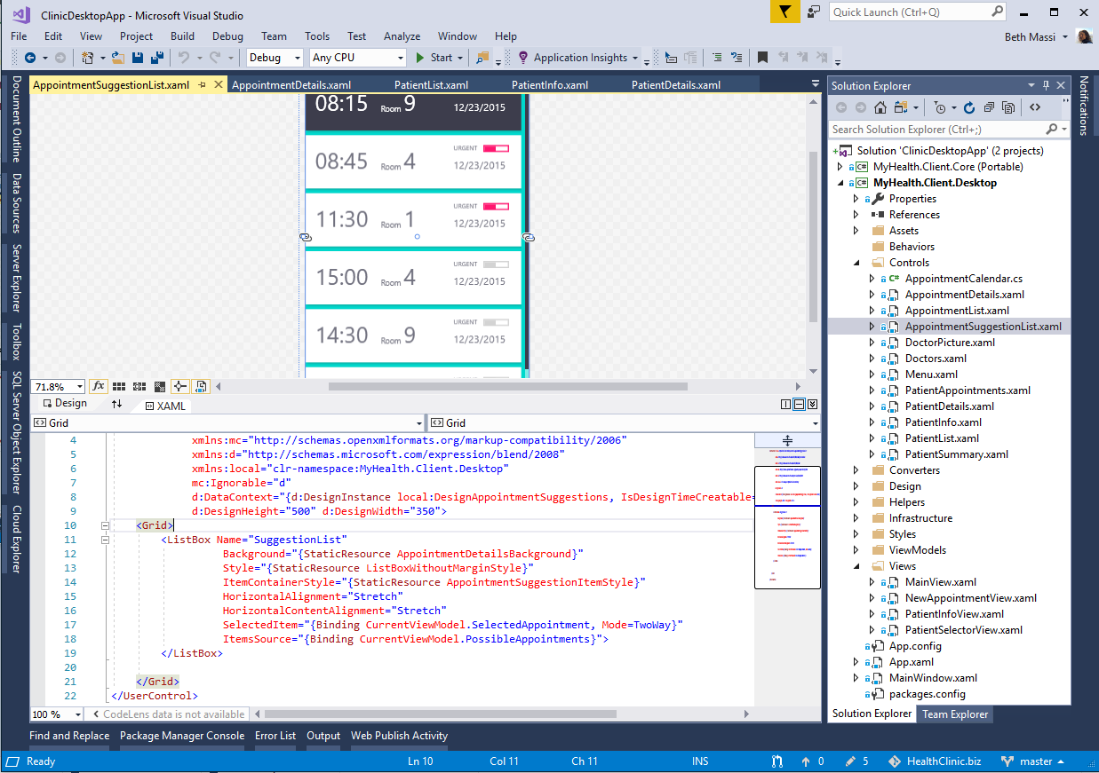
ANNOUNCING
.NET Core 3.0 preview 5
Windows desktop support with WPF and WinForms, also open source
Flexible deployment, side-by-side support and self-contained EXEs
Full-stack web development with C# and Razor
Significant performance improvements
New C# language features for productivity and less errors
dot.net/get-core3

Slide 8


.NET Core 3.0 themes
Windows
desktop apps
Full-stack web development
Artificial intelligence & Machine Learning
Big data

Slide 9
C# 8.0
static async Task Main(string[] args)
{
IAsyncEnumerable<Customer?> customers
= GetCustomersAsync(args[2..]);
await foreach (Customer? customer in customers)
{
string? name = customer switch
{
null => null,
(null, string ln) => $"Ms/Mr {ln}",
(string fn, string ln) => $"{fn[0]}. {ln}",
};
if (name != null) Console.WriteLine(name);
}
}

Slide 10
C# 8.0
static async Task Main(string[] args)
{
IAsyncEnumerable<Customer?> customers
= GetCustomersAsync(args[2..]);
await foreach (Customer? customer in customers)
{
string? name = customer switch
{
null => null,
(null, string ln) => $"Ms/Mr {ln}",
(string fn, string ln) => $"{fn[0]}. {ln}",
};
if (name != null) Console.WriteLine(name);
}
}
Ranges

Slide 11
C# 8.0
static async Task Main(string[] args)
{
IAsyncEnumerable<Customer?> customers
= GetCustomersAsync(args[2..]);
await foreach (Customer? customer in customers)
{
string? name = customer switch
{
null => null,
(null, string ln) => $"Ms/Mr {ln}",
(string fn, string ln) => $"{fn[0]}. {ln}",
};
if (name != null) Console.WriteLine(name);
}
}
Ranges
Nullable reference types

Slide 12
C# 8.0
static async Task Main(string[] args)
{
IAsyncEnumerable<Customer?> customers
= GetCustomersAsync(args[2..]);
await foreach (Customer? customer in customers)
{
string? name = customer switch
{
null => null,
(null, string ln) => $"Ms/Mr {ln}",
(string fn, string ln) => $"{fn[0]}. {ln}",
};
if (name != null) Console.WriteLine(name);
}
}
Ranges
Nullable reference types
Async streams

Slide 13
C# 8.0
static async Task Main(string[] args)
{
IAsyncEnumerable<Customer?> customers
= GetCustomersAsync(args[2..]);
await foreach (Customer? customer in customers)
{
string? name = customer switch
{
null => null,
(null, string ln) => $"Ms/Mr {ln}",
(string fn, string ln) => $"{fn[0]}. {ln}",
};
if (name != null) Console.WriteLine(name);
}
}
Ranges
Nullable reference types
Async streams
Switch expressions

Slide 14
C# 8.0
static async Task Main(string[] args)
{
IAsyncEnumerable<Customer?> customers
= GetCustomersAsync(args[2..]);
await foreach (Customer? customer in customers)
{
string? name = customer switch
{
null => null,
(null, string ln) => $"Ms/Mr {ln}",
(string fn, string ln) => $"{fn[0]}. {ln}",
};
if (name != null) Console.WriteLine(name);
}
}
Ranges
Nullable reference types
Async streams
Switch expressions
Recursive patterns

Slide 15
C# 8.0
static async Task Main(string[] args)
{
IAsyncEnumerable<Customer?> customers
= GetCustomersAsync(args[2..]);
await foreach (Customer? customer in customers)
{
string? name = customer switch
{
null => null,
(null, string ln) => $"Ms/Mr {ln}",
(string fn, string ln) => $"{fn[0]}. {ln}",
};
if (name != null) Console.WriteLine(name);
}
}
Ranges
Nullable reference types
Async streams
Switch expressions
Recursive patterns
Default implementations
And more…

Slide 16
ASP.NET Core 3.0
gRPC
High performance contract-based RPC services with .NET
Works across many languages and platforms
Worker service
Starting point for long running back processes like Windows Server or Linux daemon
Producing or consuming messages from a message queue
Web API’s + identity
Add security and authentication to Web API’s

Slide 17



.NET Core 3.0: A full stack solution
Client
Frontend
Backend
http://..
gRPC
gRPC
Worker
ASP.NET Core
Blazor
Components
SPA (JavaScript)
MVC / Razor Pages
Web APIs
SignalR
Security & identity
Worker services
gRPC

Slide 18
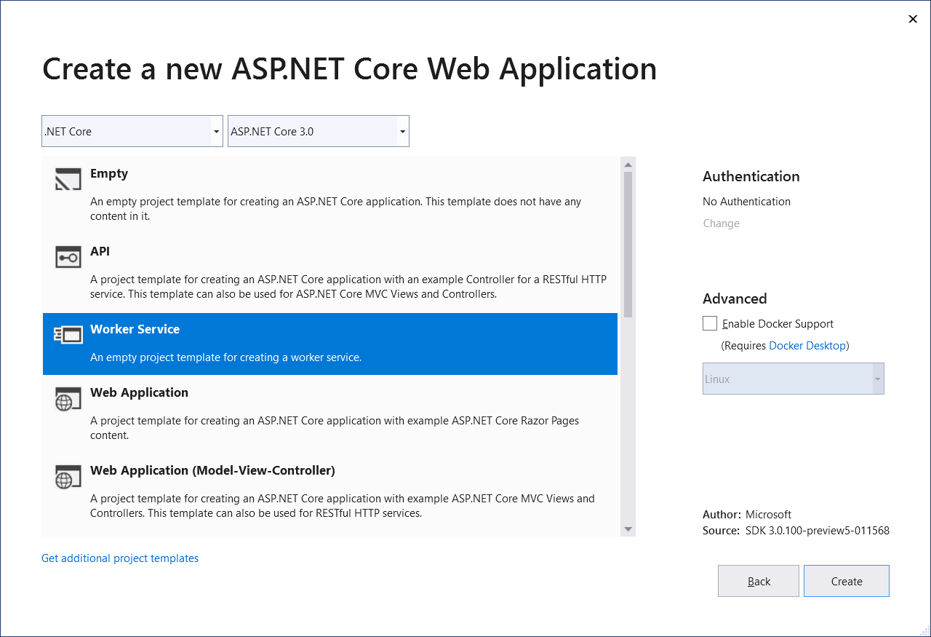
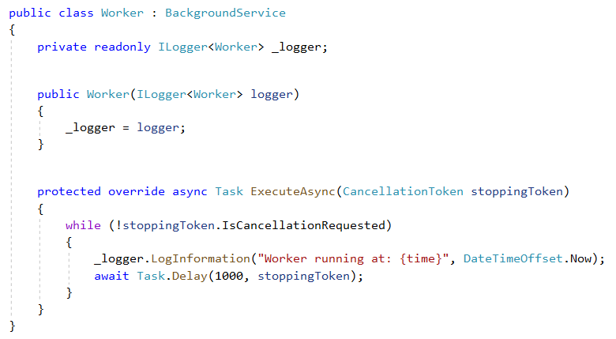
Worker services
New Worker service template
Build long-running worker processes
May or may not have endpoints
Host in Windows services, systemd, WebJobs, containers
Integrates with configuration, logging, dependency injection

Slide 19
ASP.NET Core 3.0 Blazor
Full stack web development with C#
You don’t need to know AngularJS, React, Vue, etc.
Take advantage of stability and consistency of .NET
Runs in all browsers
Strongly typed on the client and server
Share C# code with the client and server
Web assembly (optional and in preview)
Native performance
Requires no plugin or code transpilation

Slide 20


Blazor
Build client-side web UI with .NET instead of JavaScript
Write reusable web UI components with C# and Razor
Share .NET code with both the client and the server
Call into JavaScript libraries & browser APIs as needed
Blazor for WebAssembly now in official preview!
C#

Slide 21


Blazor on client or server
Client-side
Server-side
https://...
https...
ASP.NET Core
Razor Components
DOM
SignalR
DOM
.NET
WebAssembly
Razor Components
.NET
Future
.NET Core 3.0

Slide 22

Performance Improvements
Plaintext (MW)
JSON (MW)
JSON (MVC)
Fortunes (MW)
2.2
3.1M RPS
650 ms TTFR
1,342 MB
690K RPS
768 ms TTFR
1,205 MB
373K RPS
1,324 ms TTFR
1,198 MB
248K RPS
1,325 ms TTFR
1,268 MB
3.0
4.35M RPS
356 ms TTFR
103 MB
+39%
-45%
-92%
785K RPS
476 ms TTFR
516 MB
+13%
-38%
-57%
438K RPS
661 ms TTFR
528 MB
+15%
-50%
-56%
261K RPS
990 ms TTFR
733 MB
+5%
-25%
-42%
Where did the improvements come from?
Reducing allocations (Plaintext is now “allocation-free”)
Endpoint Routing
Tiered Compilation JIT
Improved GC memory reservation defaults
And we’re not finished yet…
All results taken from https://aka.ms/aspnet/benchmarks on Linux

Slide 23
Also new in ASP.NET Core 3.0
Simplified shared framework
Blazor (server-side)
gRPC
Worker
IdentityServer
API code generation
Endpoint routing integration
C# 8 in Razor & MVC
JSON
Windows service support
SignalR auto-reconnect, streaming
SignalR C++ client*
Event counters*
Certificate & Kerberos authentication*
Performance
*Coming soon!

Slide 24
Key takeaways
.NET continues to expand to more workloads
ML.NET 1.0—dot.net/ml
.NET for Spark preview—dot.net/spark
.NET Core is the future of .NET
.NET Core preview 3—dot.net/get-core3
Build new applications on .NET Core
Keep existing applications on .NET Framework

Slide 25
Try .NET Core 3.0 with ASP.NET Core & Blazor today!
Download: https://dot.net/get-core3
Visual Studio: https://visualstudio.com/preview
Docs: https://docs.asp.net
Blazor: https://blazor.net
Workshop: https://aka.ms/blazorworkshop

Slide 26
Your platform for building anything
DESKTOP
WEB
CLOUD
MOBILE
GAMING
IoT
AI
.NET

